Slide 1
SESSION 0 - INTRODUCTION
COWI Python Workshop
Kenneth C. Kleissl (KEKL) Tim Skov Jacobsen (TSJA)

Slide 2
Python 101 - Program
Session 0 – Introduction
Python the programming language
Showcase of example applications
Exercises
Session 1 – Data Types
Session 2 – Data Structures
Session 3 – Functions
Session 4 – Plotting
Session 5 – Dataframes
Session 6 – Practical Exercise
Session 7 – Coordinate Transformation
Session 8 – Interpolation
Session 9 – Heatmaps and Merging Operation

Slide 3

What is Python?
Now officially retired
Python was conceived in the late 1980s by Guido van Rossum and
it’s an interpreted, high-level, general-purpose programming language.
Interpreted: no compiling, interactive
High-level: high abstraction level,
garbage-collected (auto. memory management),
dynamically typed (with possibility of statical typing)
General-purpose: multi-paradigm (object-oriented, functional, reflective, imperative),
extremely versatile (scripting, application, server etc.)
Named after the Monty Python's Flying Circus (television show)
Wanted a short, unique, and slightly mysterious name

Slide 4
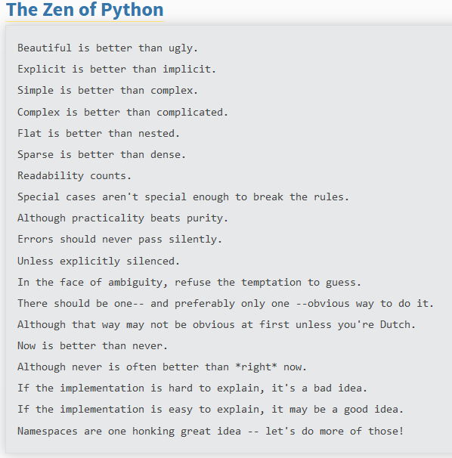
Philosophy behind Python?
High readability (reads like English)
The simple readable syntax makes it very beginner friendly (great first programming language)
Intuitive Error handling:
try before you ask
(
)
Guido van Rossum

Slide 5
Why Python?
The language is easy to use, powerful, versatile, and productive
Very approachable (also for non-developers)
Speed of coding (approx. x5 faster than typical low-level language)
Free to use (open source) - High pace of development
Huge, healthy, active and supportive community (easy to find help)
Batteries included (many built-in features and countless 3rd-party libraries)
Highly compatible (great interface tool)

Slide 6
Sounds like a good idea?

Slide 7

What about the pros?
Instagram – All Python!
Reddit – All Python!
Dropbox – Desktop client is written entirely in Python (400 million users)
Google
Had to buy YouTube because of too fast feature implementation
”Python where we can, C++ where we must”
Facebook, Netflix, Spotify, NASA, CERN, Yahoo!, Wikipedia …
Corporate support (many libraries fully maintained by developers at Google, Facebook etc.)
Scalable and maintainable
First photo of a black hole

Slide 8
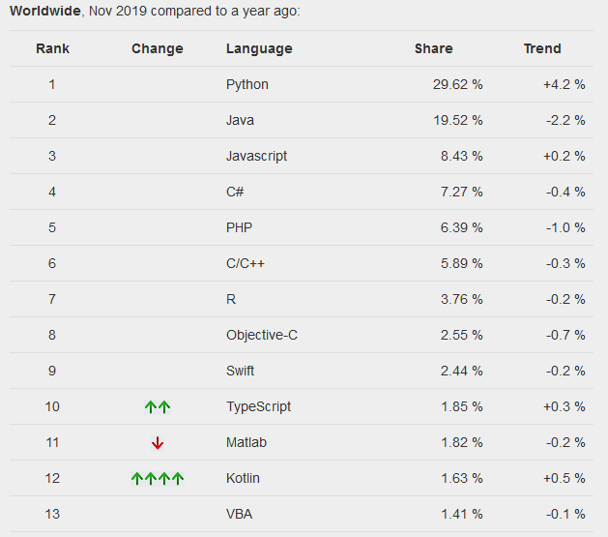
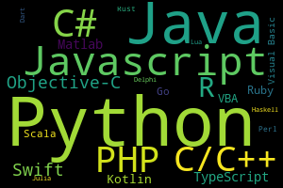
Python’s popularity
PYPL (PopularitY of Programming Language) based on Google searches
Most popular language
Fastest-growing language

Slide 9
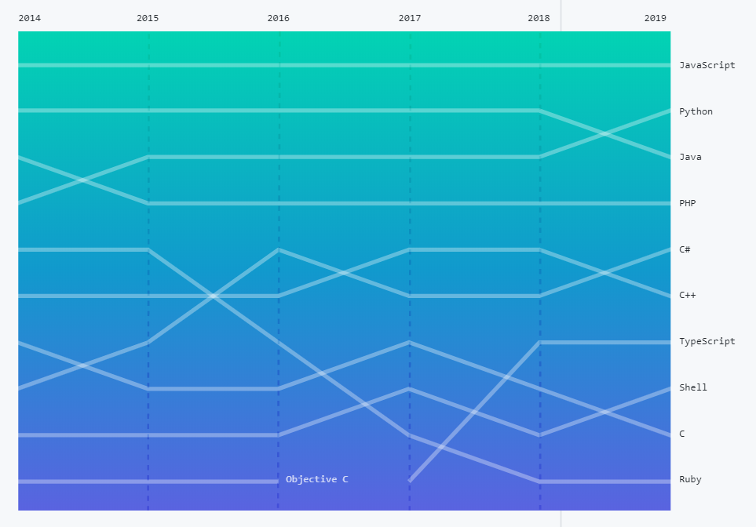
Python’s popularity
GitHub’s largest languages (the world’s largest repository host)
Highly popular language
Fast growing language

Slide 10
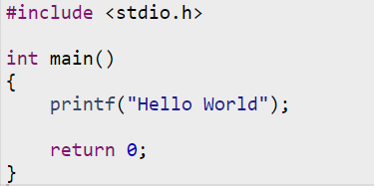

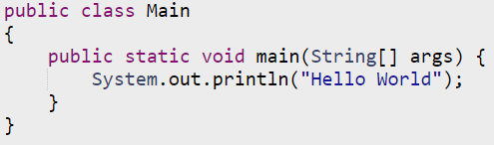
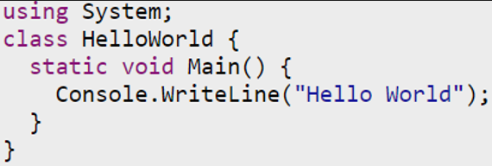
Hello World in six languages
C/C++
Fortran
Java
MATLAB
Python
C# (pronounced C-sharp)
Low level / High level languages
Simple explanation of why Python is so popular.

Slide 11
What can you do with Python?
Automate the boring stuff
Scripts for repetitive/manual tasks
Software development
Desktop GUI applications
Web development
Websites and web applications
Dashboards
Data Science
Data management/handling/processing/analysis
Data visualization
Machine Learning, Deep Learning/AI etc.
Web scraping
IOT, Smart House control, embedded applications and much much more

Slide 12
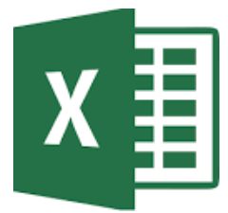
Excel
Excel is a great tool and will never be replaced by Python!
But you should properly consider Python instead if you:
Use VBA
Do many repetitive tasks
Do advanced visualization
Have a large project you need to maintain
Have several developers
Interacts with other applications
Work with large data sets
If you struggle to maintain an overview
Needs version-control
Python interacts very well with Excel

Slide 13

Matlab
Matlab is a great tool but…
Anything you can do in Matlab you can also do in Python for free!
and
You can do many things in Python you cannot do in Matlab
Python and Matlab interacts very well
Matlab is not going anywhere but have lost a significant market share to the open-source community

Slide 14
Examples

Slide 15
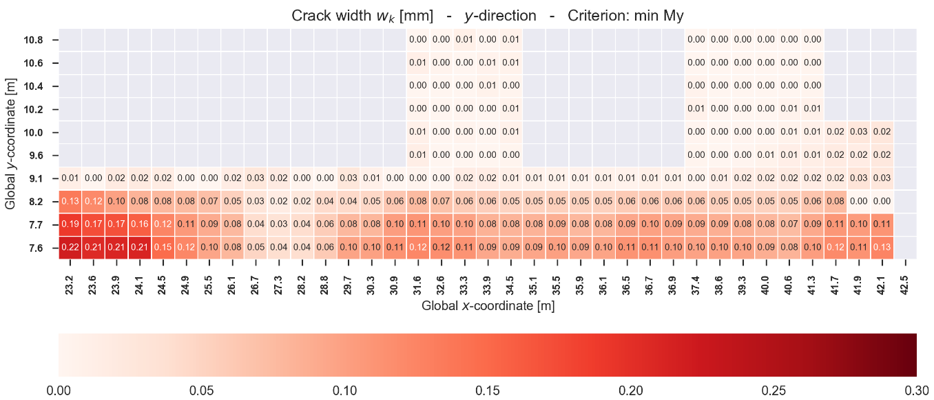
Examples - Plotting
Heatmap of crack widths in base slab

Slide 16
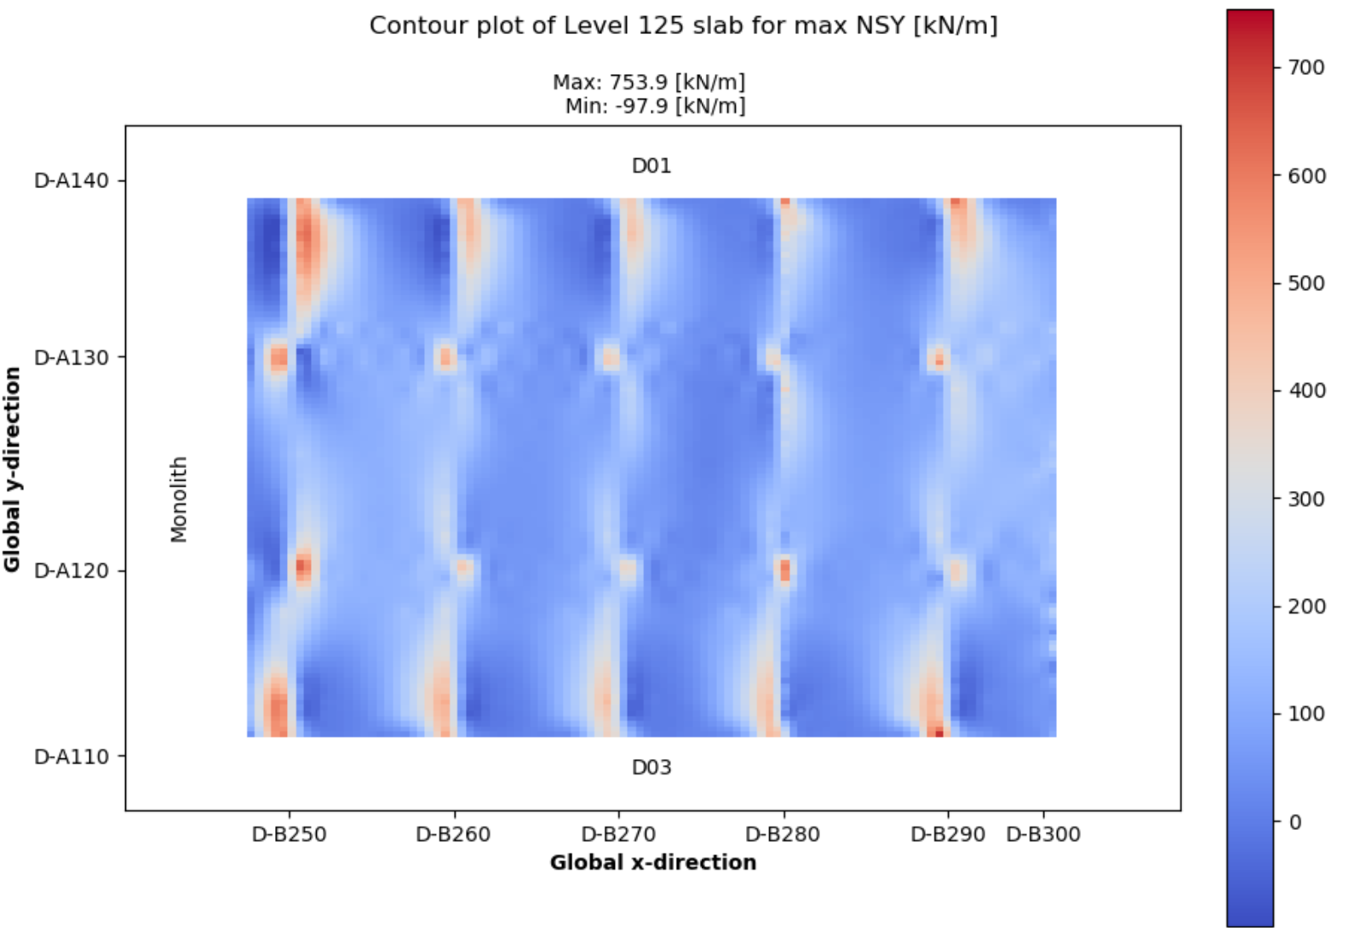
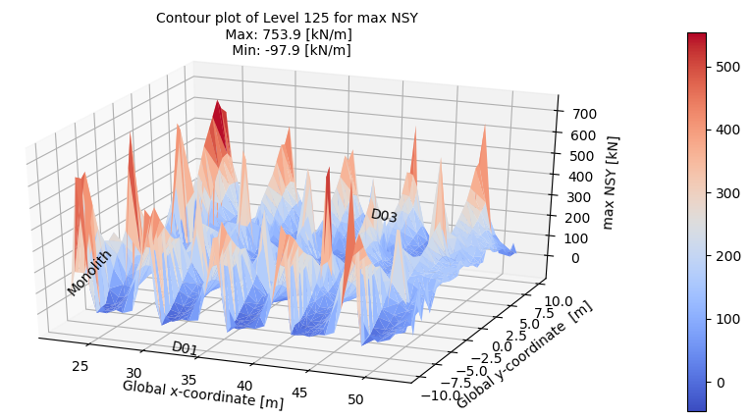
Examples - Plotting
1st floor slab results from IBDAS
Same results in two different plots
Custom text annotation
3D plot can be rotated
2D plot with custom gridlines

Slide 17
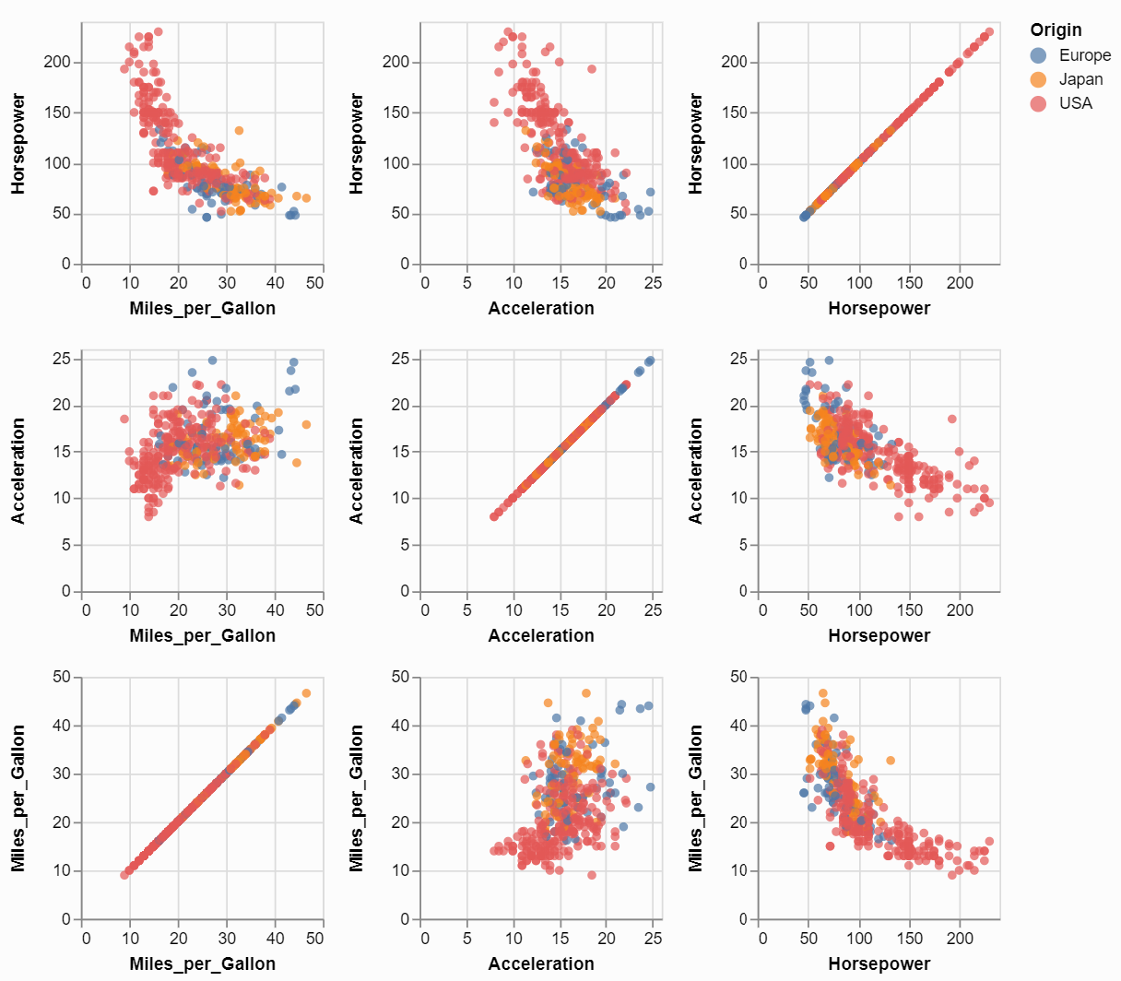
Examples - Plotting
Scatter matrix
Tiles are individual graphs
Everything plotted vs everything

Slide 18
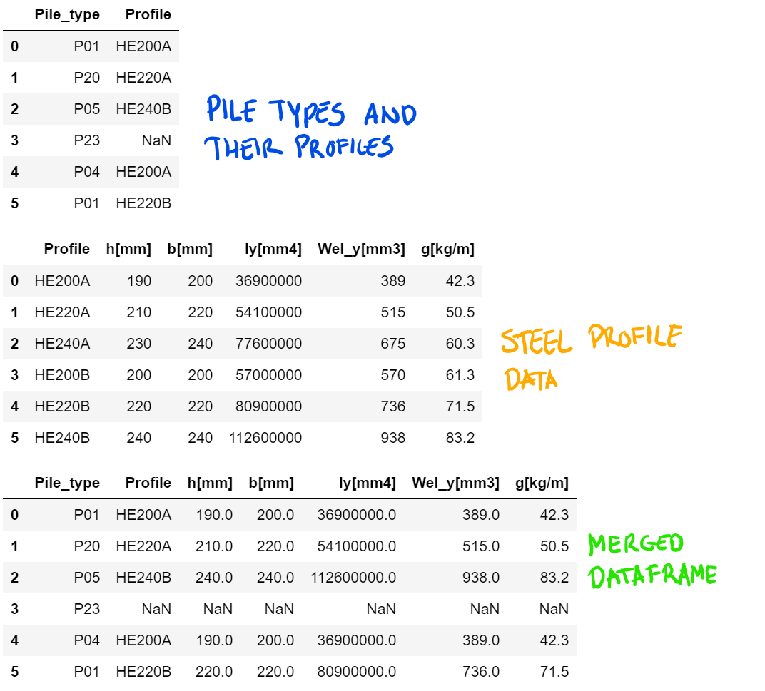
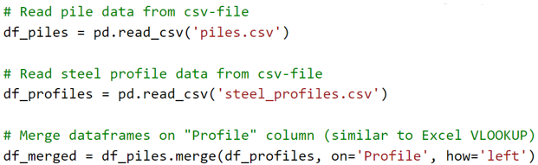
Pandas dataframes - ‘VLOOKUP’ example
Output
Scales with table sizes (both rows and columns)
Easily copied from one project to the next
Merged dataframe could be output as csv or xlsx-file to continue work in Excel
Code

Slide 19
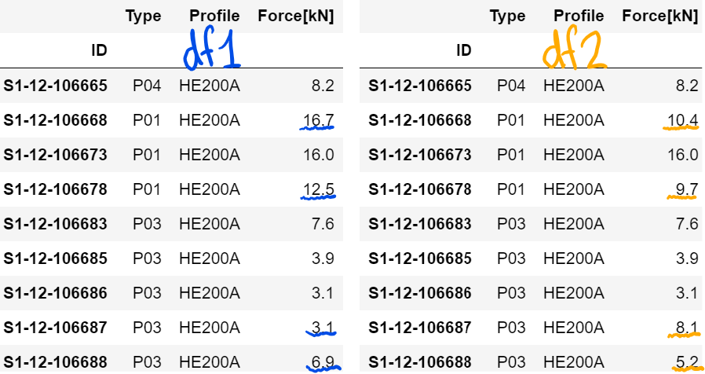
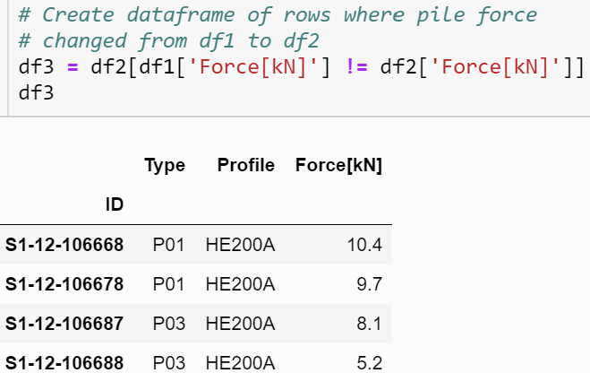
Dataframes - What changed bewteen versions?
Comparing versions of pile force data
New dataframe of only changed pile forces
One line of code
Useful for large datasets
Could be extended to show a lot more comparison details

Slide 20
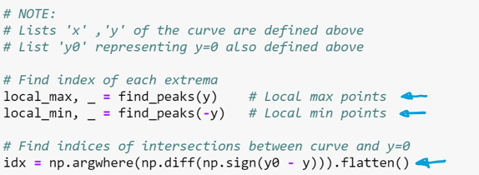
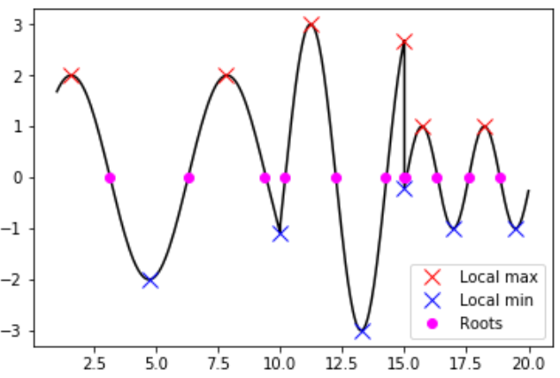
Scipy – example with peaks and roots
All points of interest found in three lines of code
Other lines are comments, imports and plotting

Slide 21
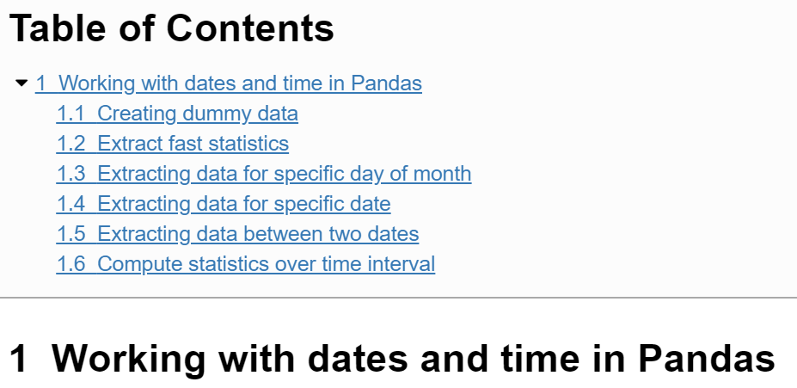
Dates and time in tables
Manipulate time series
Easy commands
Fast computations
Show demonstration in browser
(Jupyter Notebook)

Slide 22
Other things
Web scraping
Search websites for information to use in projects
E.g.: find a table in COWI portal and get its contents
Scheduling of scripts
Make scripts run at certain times or at specific intervals
Regular expressions
Search for any pattern in text
E.g.: Find all valid phone numbers in a text file
os library
Manipulate files, folders and other things in the operating system
API communication

Slide 23
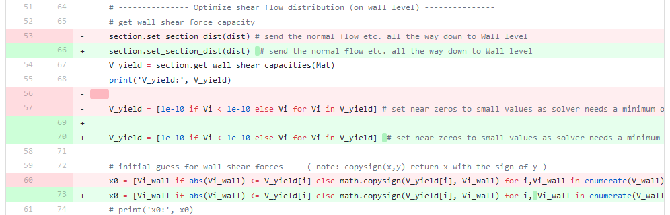
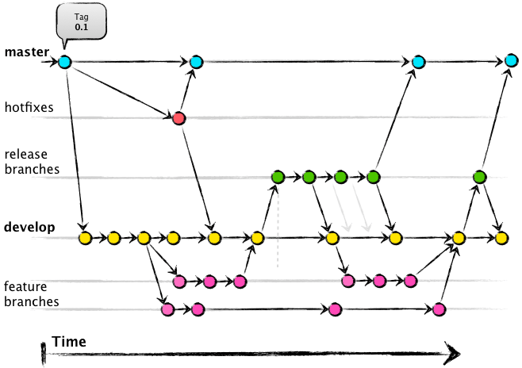
Professionel Development
Version Control
Track all code changes in a project via Git
Create developer branches and merge into master when complete
Unit Testing (QA)
Setup tests to be continuously evaluated to make sure that the changes did not break anything
Master version used in production
Critical bug
QA process
Enhancements
New features

Slide 24
Interacting with SharePoint version control
Excel pipeline document (with 1k revisions):
Please plot several selected features over time
Solution:
Python script calling the SharePoint site API to download each revision of the Excel document with timestamp as filename
Python script for looping through all the Excel documents extracting the selected features and finally dumps the collected data in new Excel document together with a visualization
Easily repeated!

Slide 25
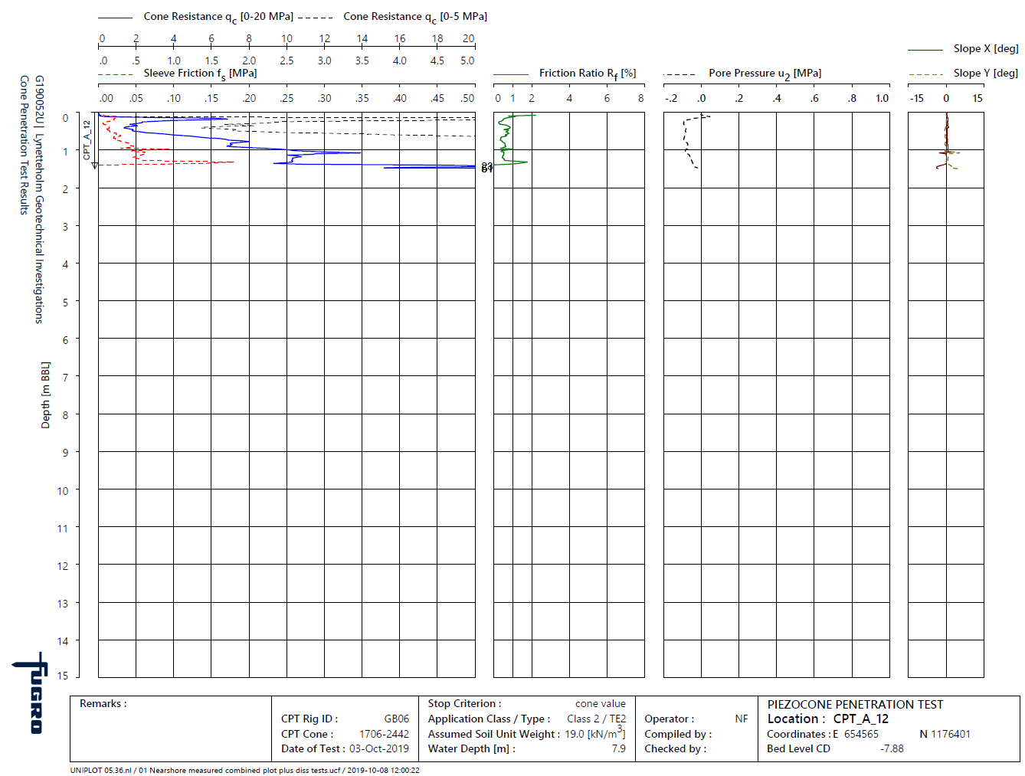
Interacting with PDF files (data extraction)
You got 100+ PDFs with data
you need to extract into Excel
Solution:
Open in BlueBeam and note page coordinates of relevant data
Python script for finding text labels with BBs encapsulating coordinates and write to Excel document

Slide 26
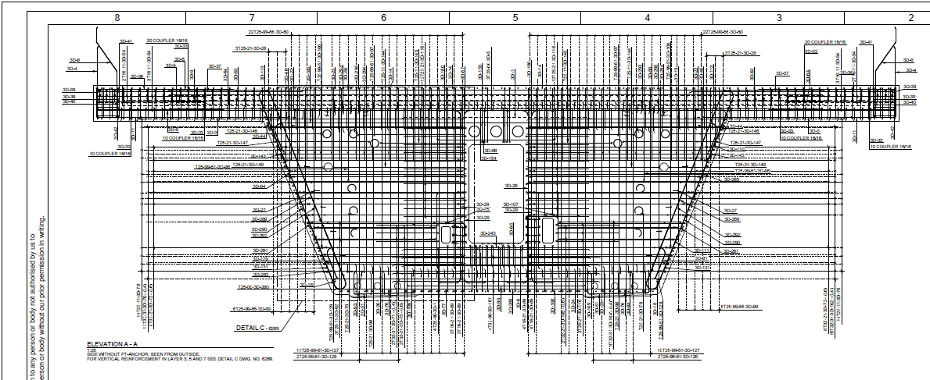
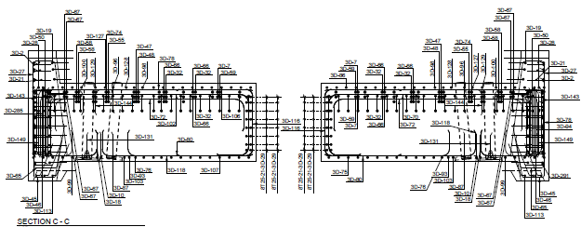
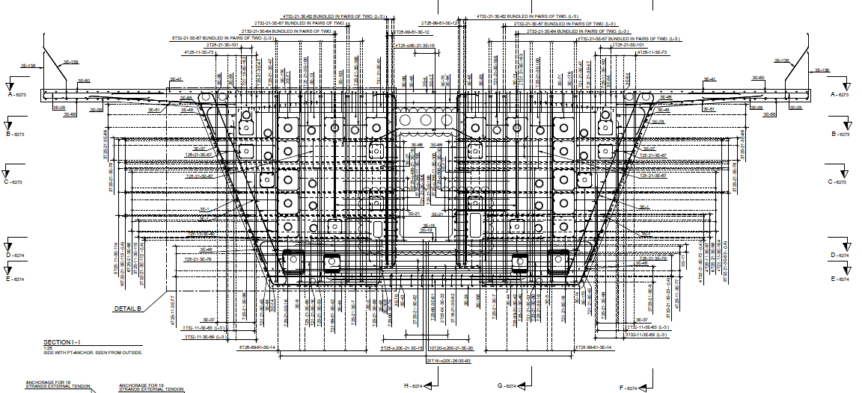
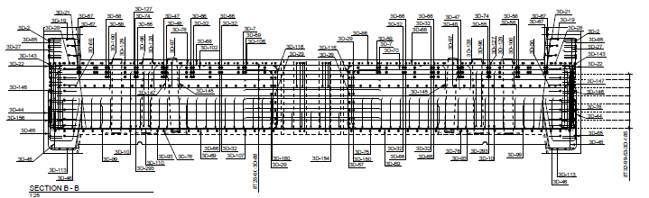
Interacting with PDF files (Drawing Checker Tool)
QA several of these and cross check with BBS

Slide 27
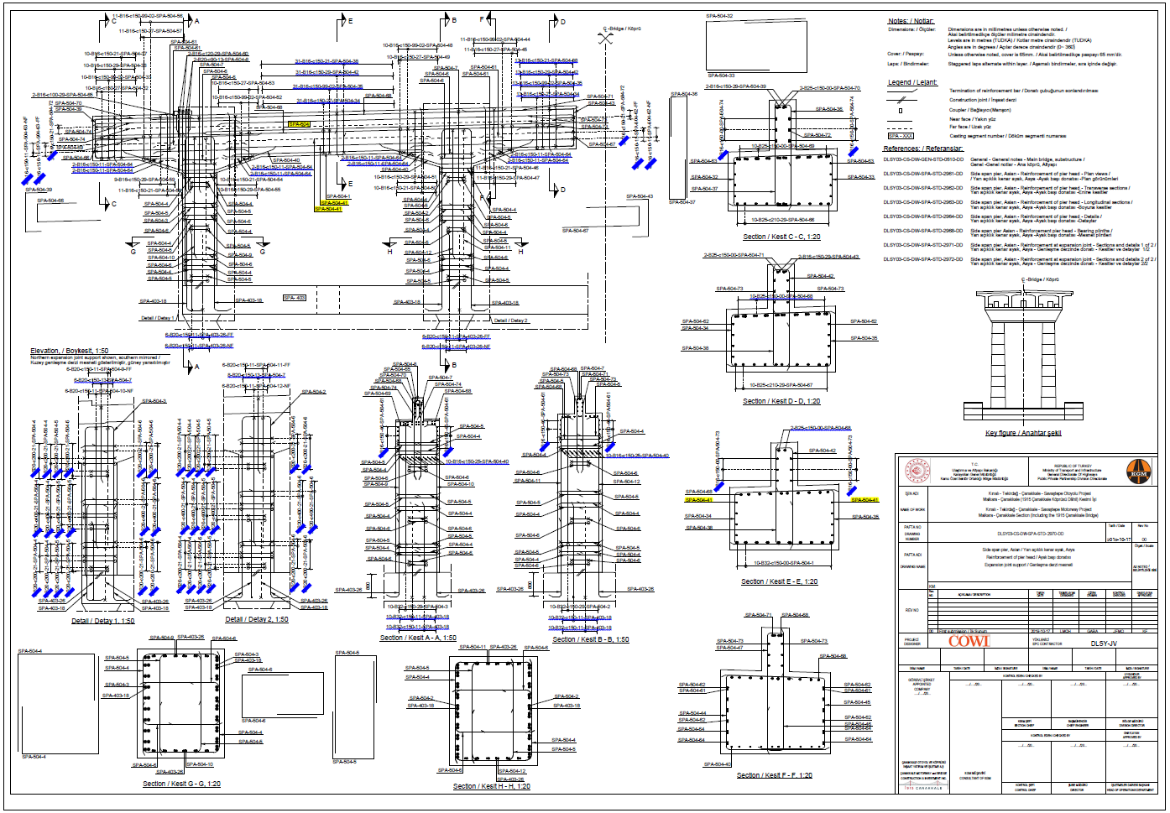
Interacting with PDF files (Drawing Checker Tool)
Automates all the trivial QA checks

Slide 28
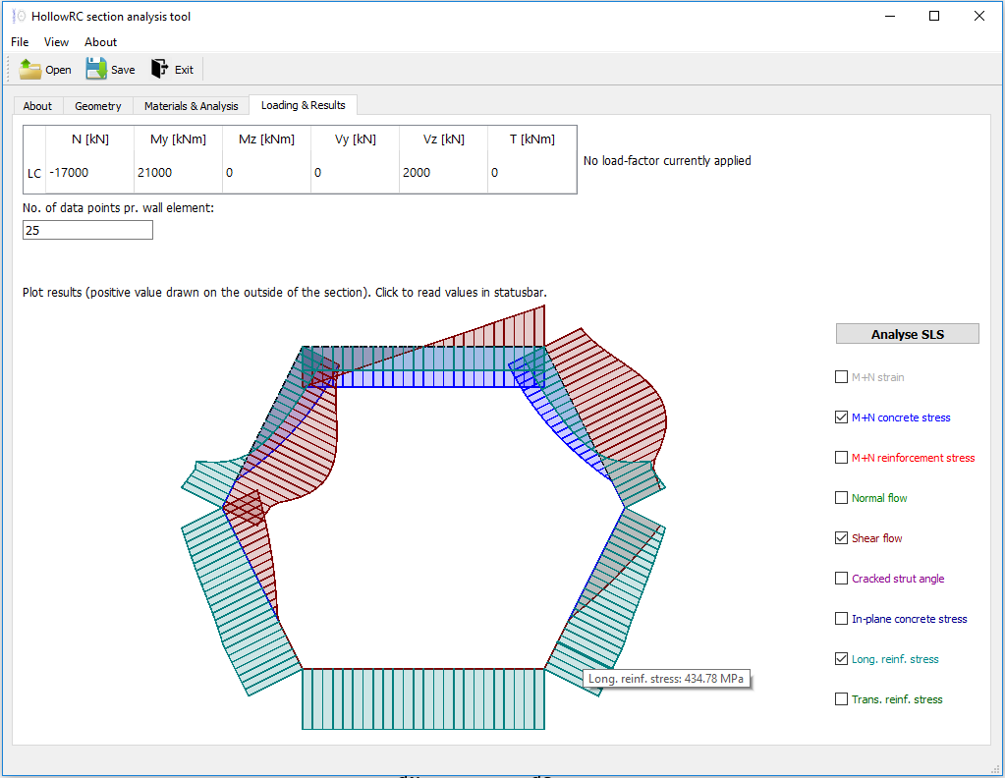
Design Tool GUI Application (HollowRC)
Leveraging advanced optimisation algorithms to automate time consuming design task

Slide 29
Exercise
Enough talking - Now it’s time for some hands-on experience
Execute your first Python script
and make that hello statement happen!
There are a couple more exercises in the course material under Session 0.

